Slide 1
EMPLOYEE MANAGEMENT SYSTEM

Slide 2

INTRODUCTION
MENTORS
COLLEGE
TRAINER: Sachin Sir
MANAGER: Prakash Sir
Usha Mittal Institute of Technology, SNDT, Mumbai
HOBBY
TECHNOLOGIES
Chess
Swimming
Listening to Music
Python
SQL
AAYUSHI PANDIT
TIE
SMARTOPS FUSION

Slide 3
PROJECT SCOPE
WHAT?
WHY?
HOW?
Develop an Employee Management System which is a software solution that helps organizations manage employee information by performing CRUD operations on dataset.
Centralizing employee information boosts efficiency by reducing manual tasks, saving time, minimizing errors, and supporting data-driven planning and improve overall workforce management.
Technology: Python for functionalities integration with MySQL for database management.
Platform: SQL Workbench for database queries and PyCharm for Python development and connectivity.

Slide 4
DATABASE DESIGN
DATABASE | EmpManage
USERS | PK: UserID
UserID | INT
UserName | VARCHAR(50)
UserPassword | VARCHAR(255)
FullName | VARCHAR(255)
MobileNumber | VARCHAR(15)
Email | VARCHAR(255)
Gender | ENUM
EMPLOYEES | PK: EmployeeID
EmployeeID | INT
FirstName | VARCHAR(50)
LastName | VARCHAR(50)
Department | VARCHAR(50)
Position | VARCHAR(50)
Salary | DECIMAL(10,2)
HireDate | DATE

Slide 5
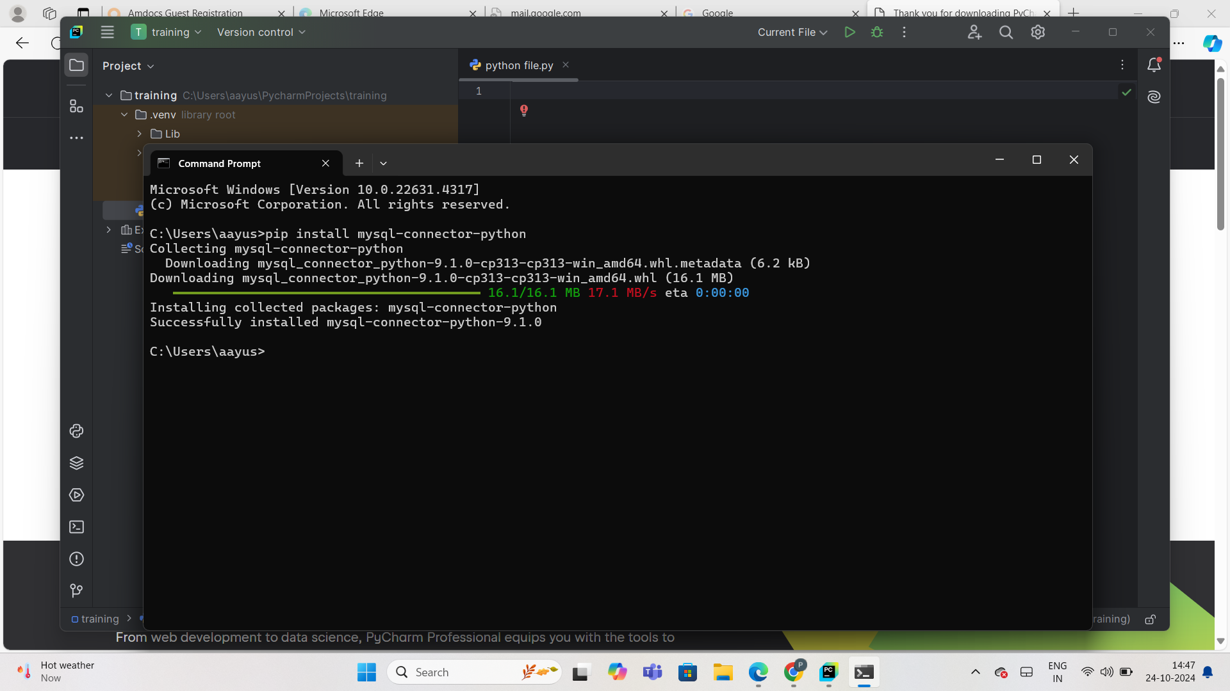
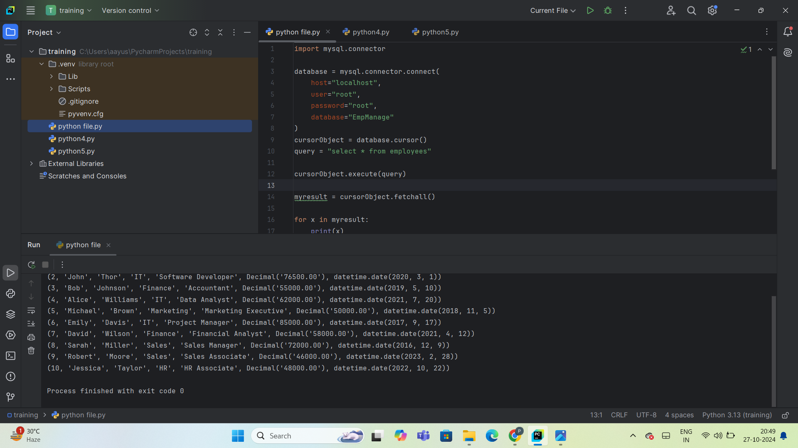
DATABASE CONNECTION
Database Connection: SQL to Python
Step-1: Install MySQL Workbench, PyCharm, and Python.
Step-2: In Command Prompt, type: pip install mysql-connector-python.
Step-3: In PyCharm, add import mysql.connector.
Step-4: Execute a SQL SELECT query in Python to verify table visibility from MySQL.

Slide 6
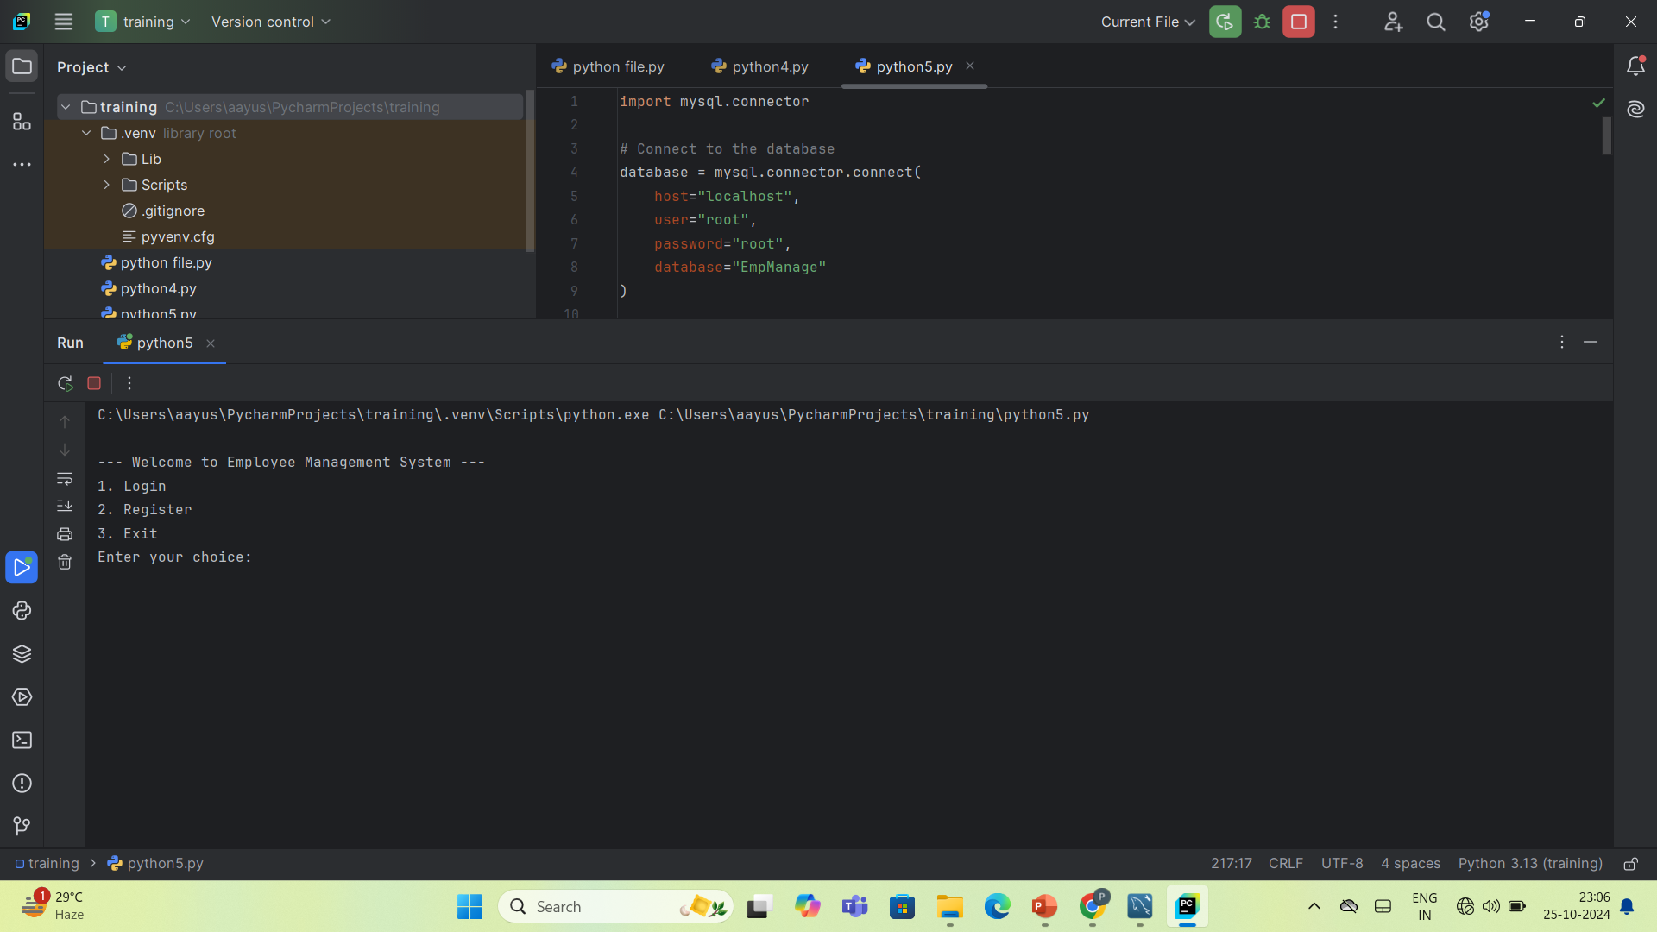
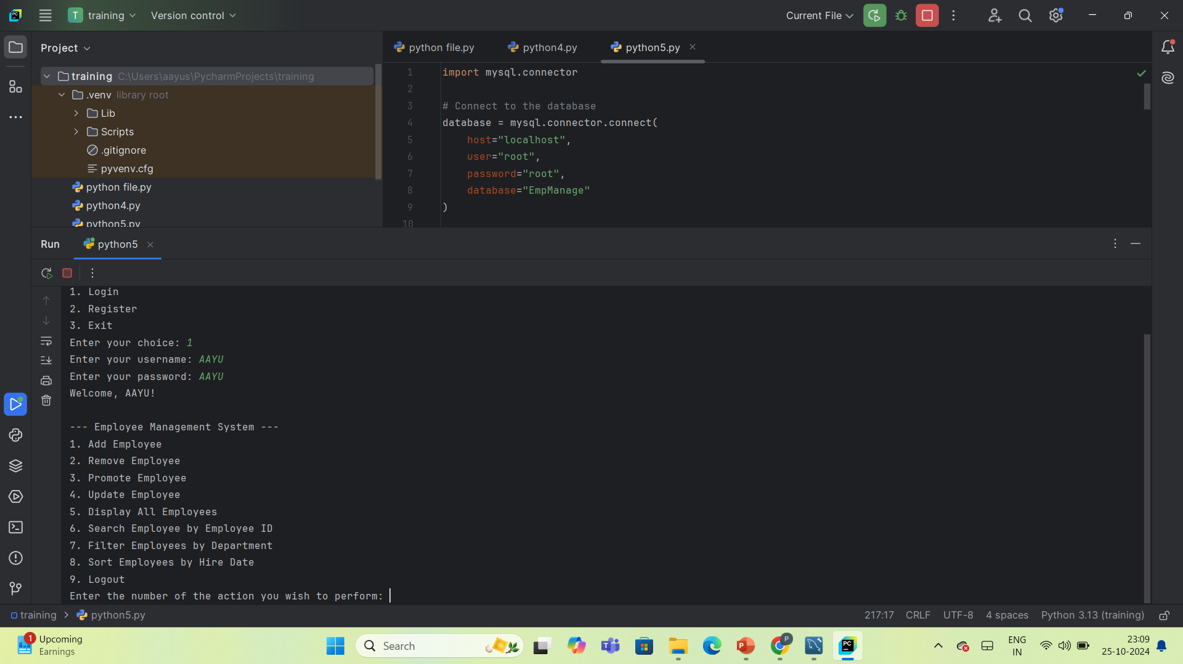
FUNCTIONALITIES
THE FUNCTIONALITIES OF EMPLOYEE MANAGEMENT SYSTEM INCLUDE:
REGISTER
LOGIN
ADD EMPLOYEE
REMOVE EMPLOYEE
PROMOTE EMPLOYEE
UPDATE EMPLOYEE
DISPLAY ALL EMPLOYEES
SEARCH EMPLOYEE
FILTER EMPLOYEES
SORT EMPLOYEES

Slide 7
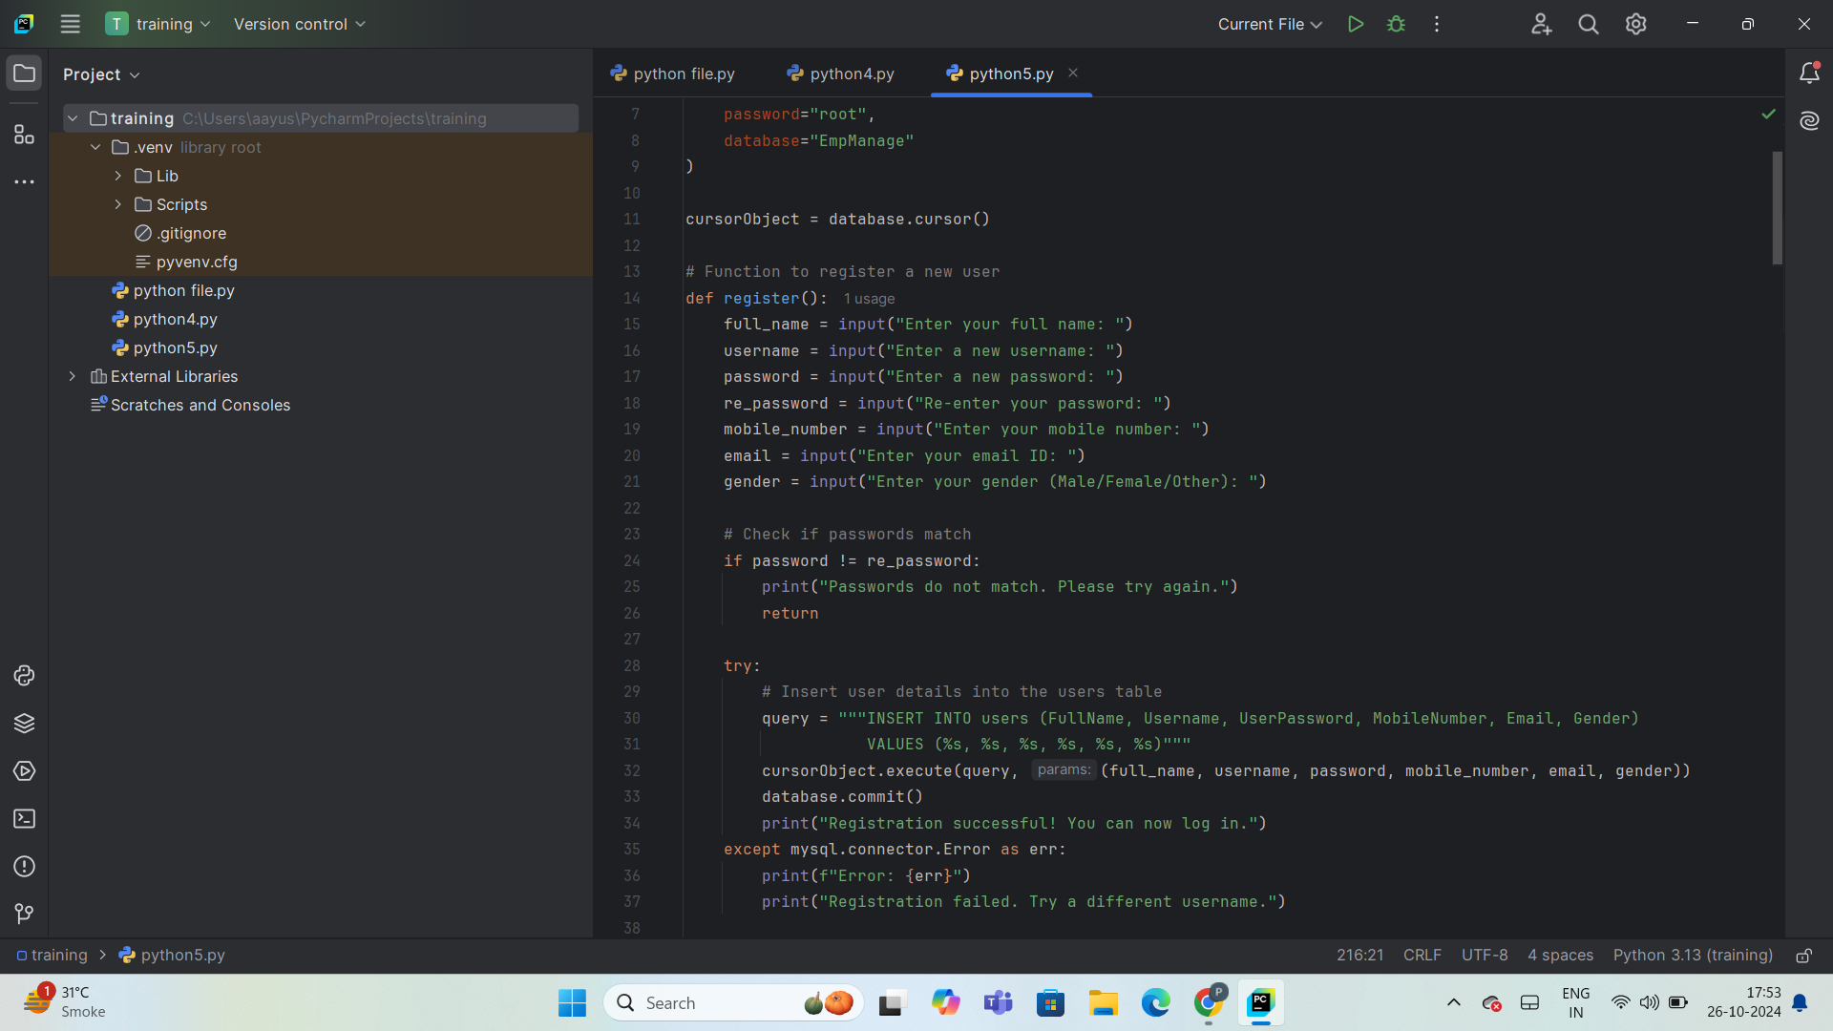
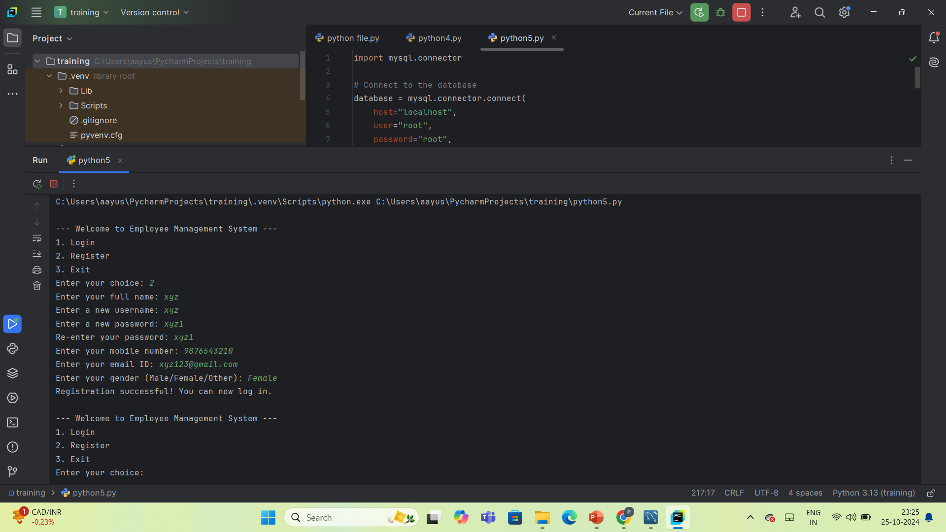
REGISTER
Purpose: Enables new users to register in the system by providing personal and login details.
Inputs:
Full Name
Username
Password
Re-password
Mobile Number
Email ID
Gender
Workflow:
Step-1: Users enter their details.
Step-2: The system validates the inputs (unique username, matching passwords).
Step-3: Data is stored in the database (MySQL).
Outcome: User registration is successful, allowing future login.

Slide 8
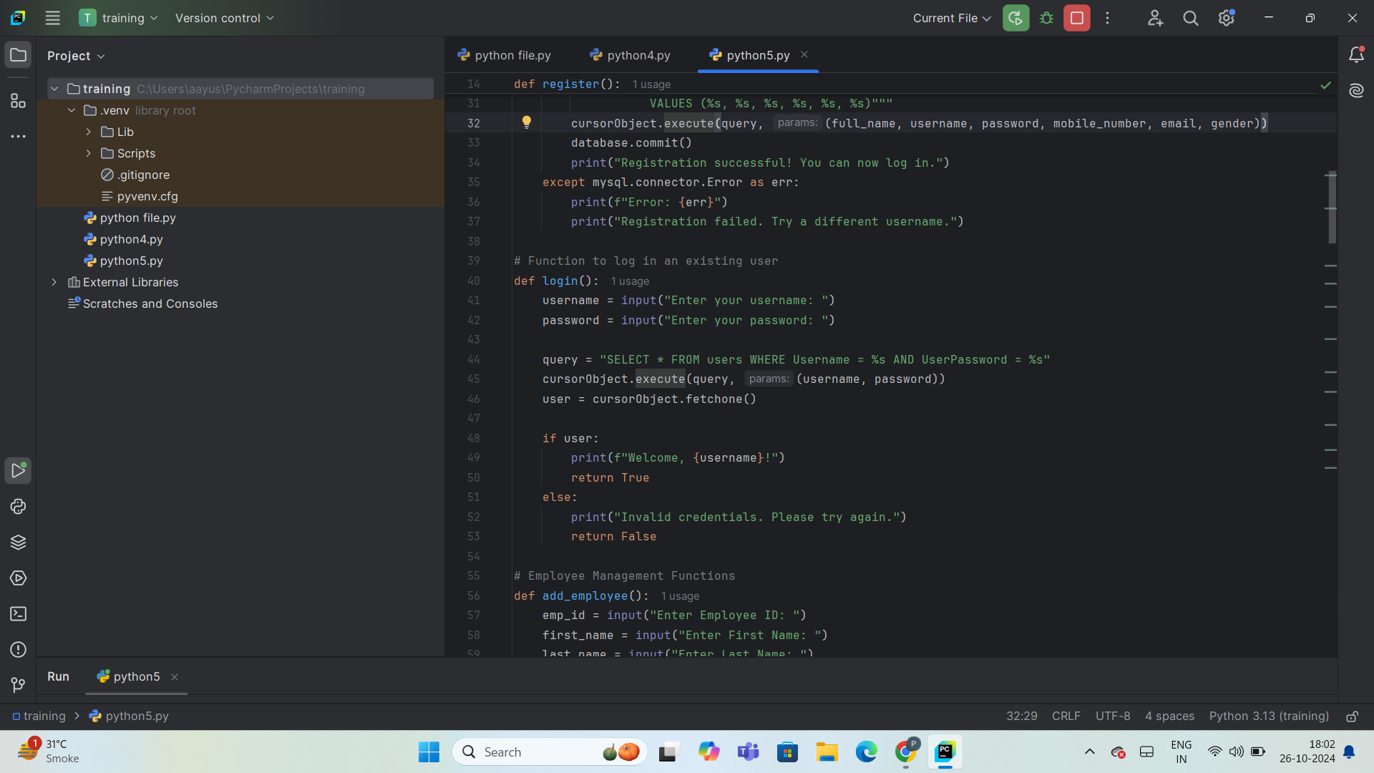
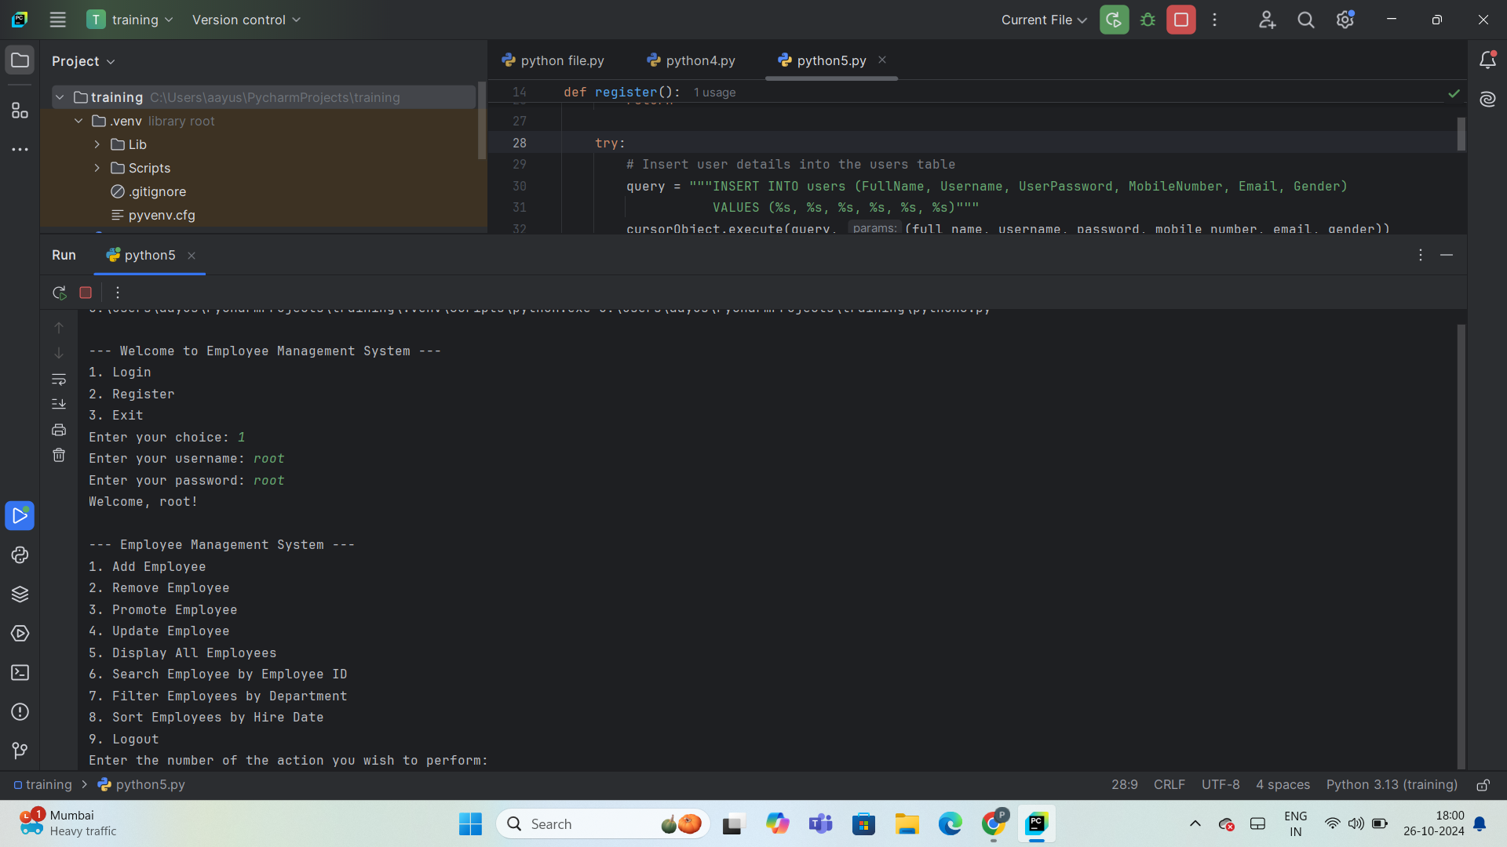
LOGIN
Purpose: Enables registered users to securely access the system by validating their username and password.
Functionality:
Prompts for login credentials.
Verifies credentials against the database.
Displays a personalized welcome message: "Welcome, [username]!“
Post-Logout Options: Access various system features like adding, removing, updating, or displaying employees.

Slide 9
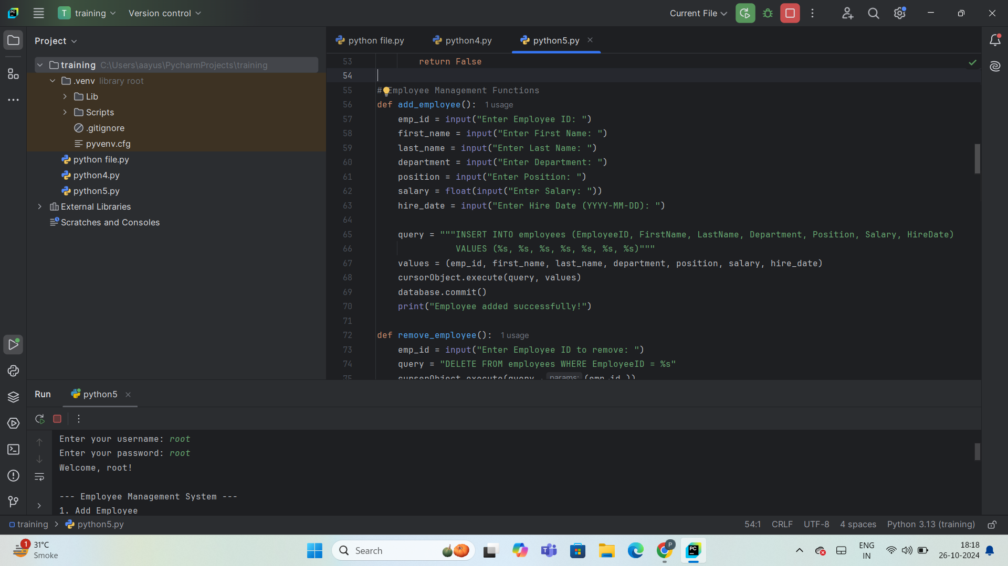
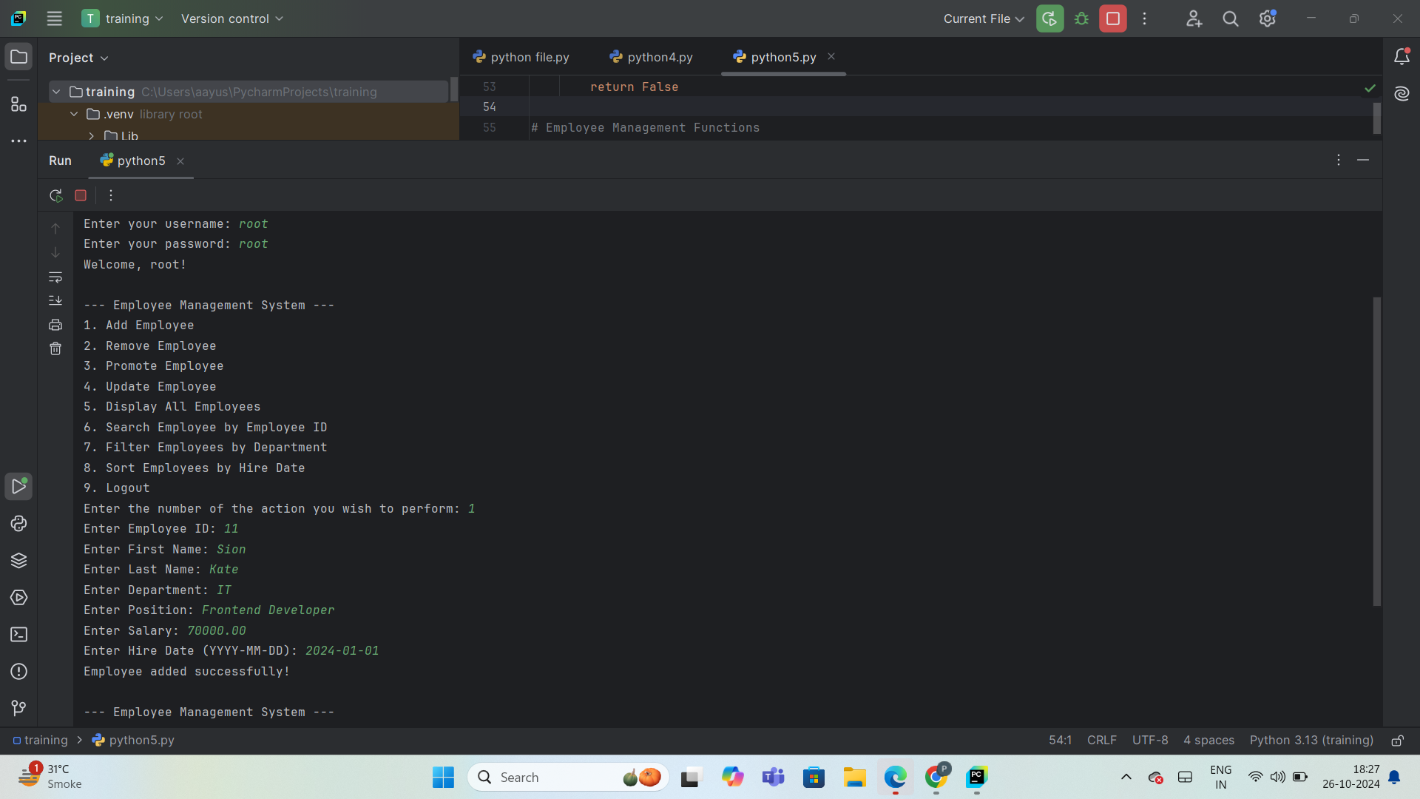
ADD EMPLOYEE
Purpose: Allows adding new employees to the database.
Inputs Required:
Employee ID
First Name
Last Name
Department
Position
Salary
Hire Date.
Process Flow:
Step-1: Collects and validates user inputs.
Step-2: Executes SQL INSERT command to save data
Step-3: Confirms with “Employee added successfully!” message.
Benefits:
Streamlined data entry with prompts.
Reduces manual entry errors.
Directly updates the database.

Slide 10
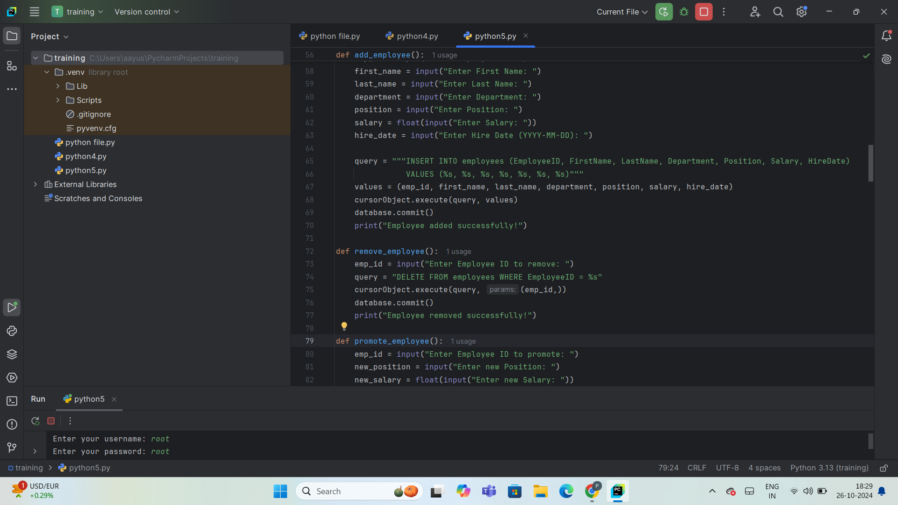
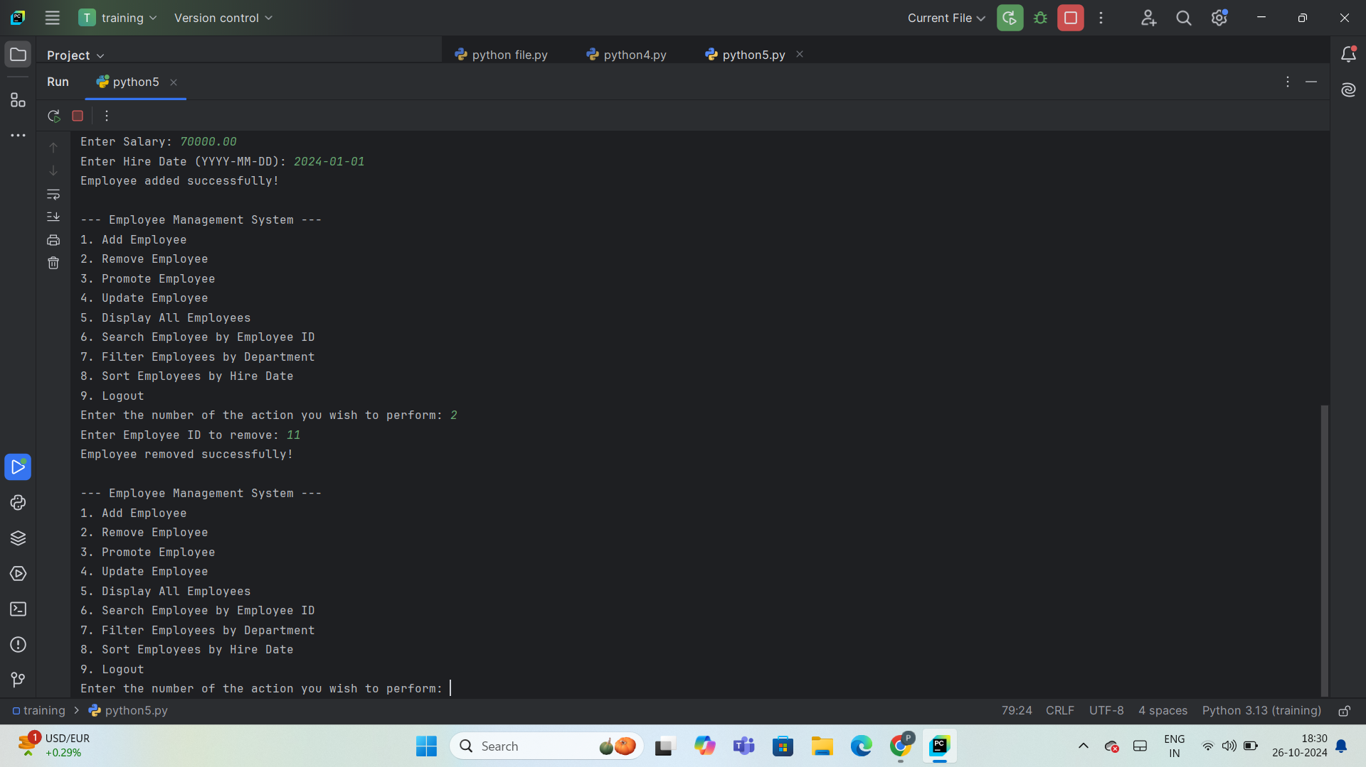
REMOVE EMPLOYEE
Purpose: Deletes an employee record by Employee ID.
Process:
Step-1: Prompts for Employee ID.
Step-2: Executes DELETE SQL Command
Step-3: Confirms with "Employee removed successfully!"
Benefit: Maintains data accuracy and integrity.

Slide 11
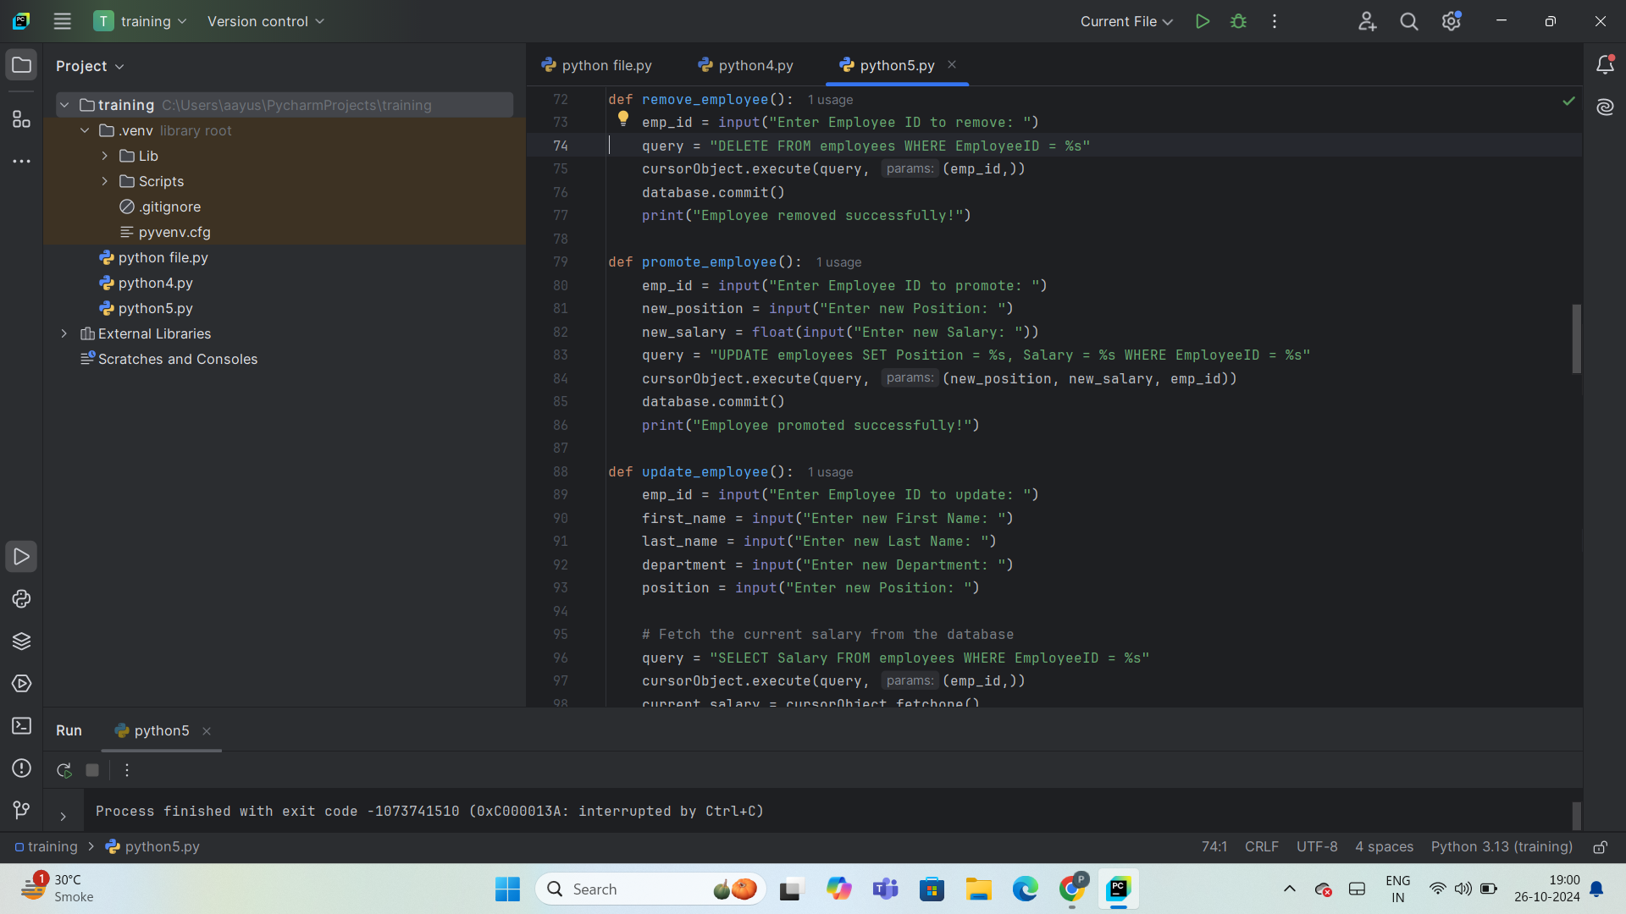
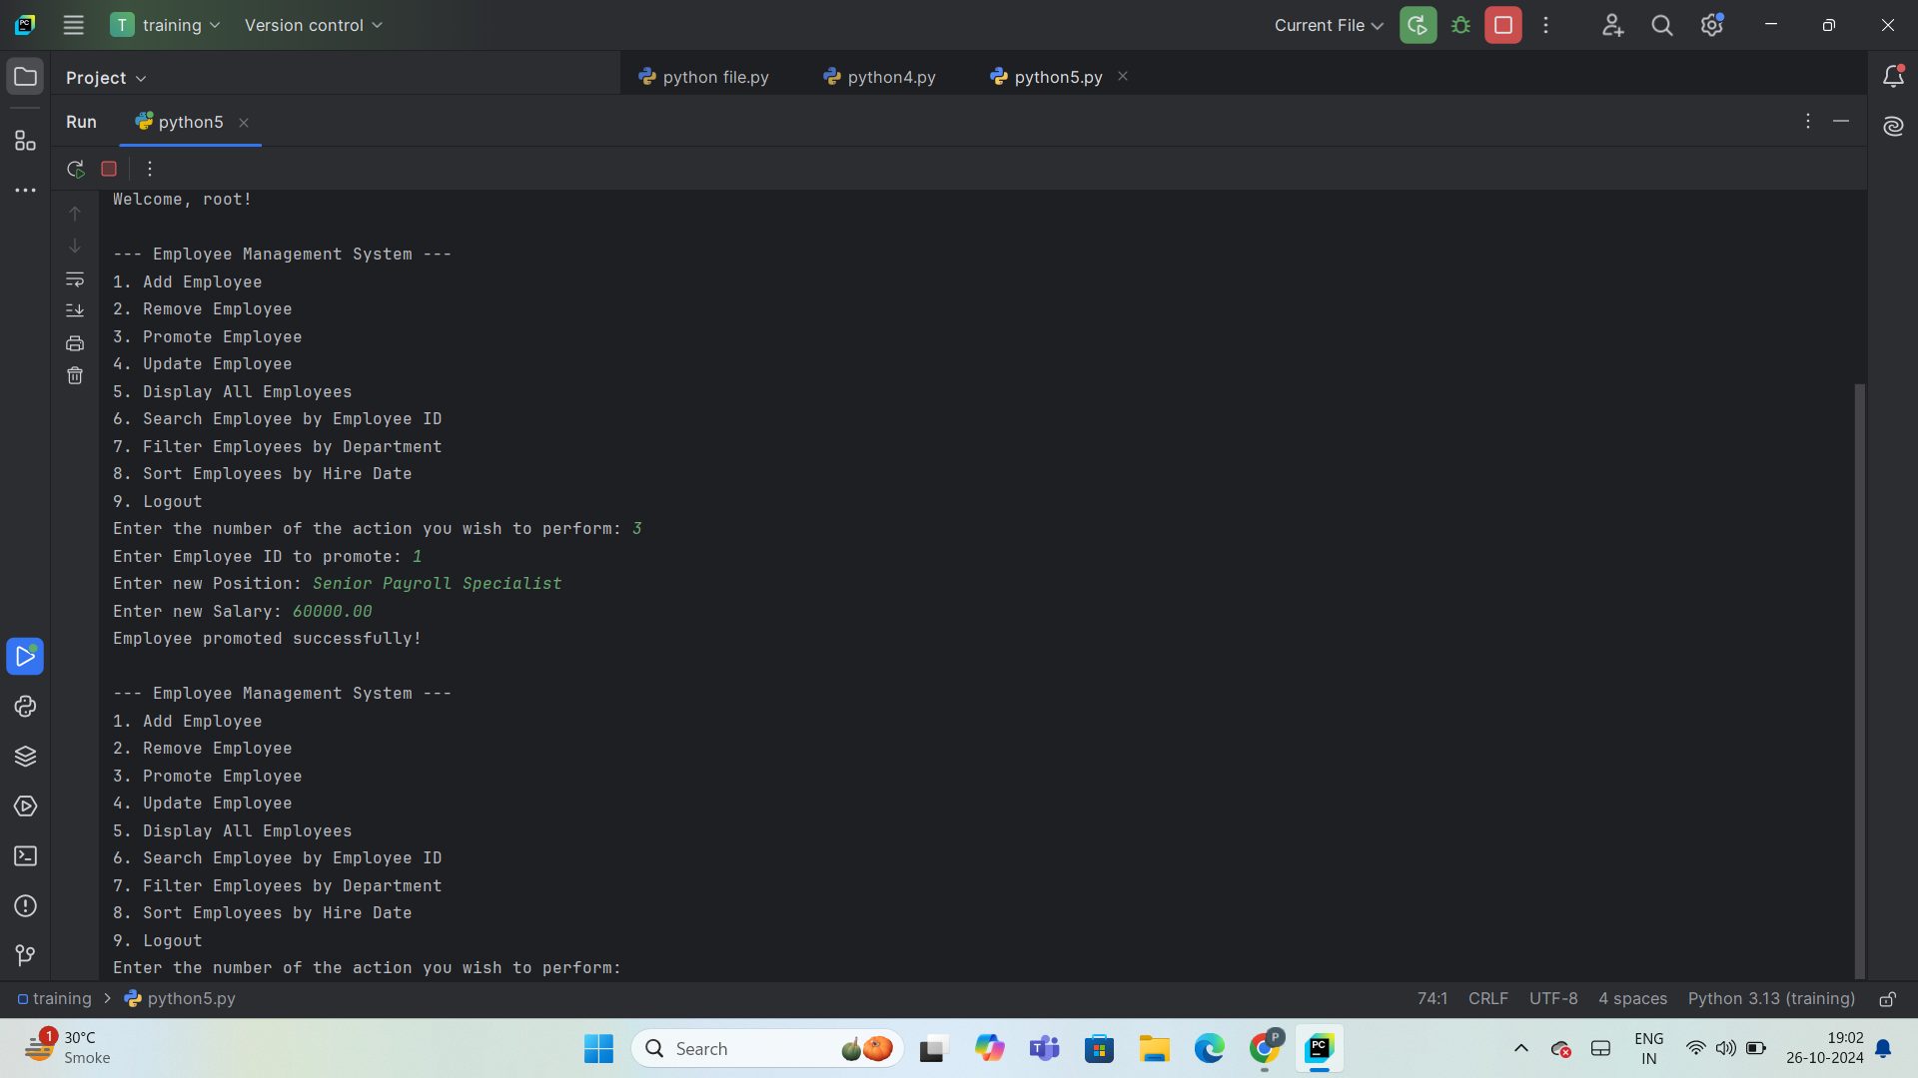
PROMOTE EMPLOYEE
Purpose: Update an employee’s position and salary upon promotion.
Process Flow:
Step-1: Enter Employee ID, New Position, and New Salary.
Step-2: System updates the database with new details.
Step-3: Displays confirmation: "Employee promoted successfully!“
Error Handling:
Ensures valid Employee ID is entered.
Validates salary format (e.g., numeric).

Slide 12
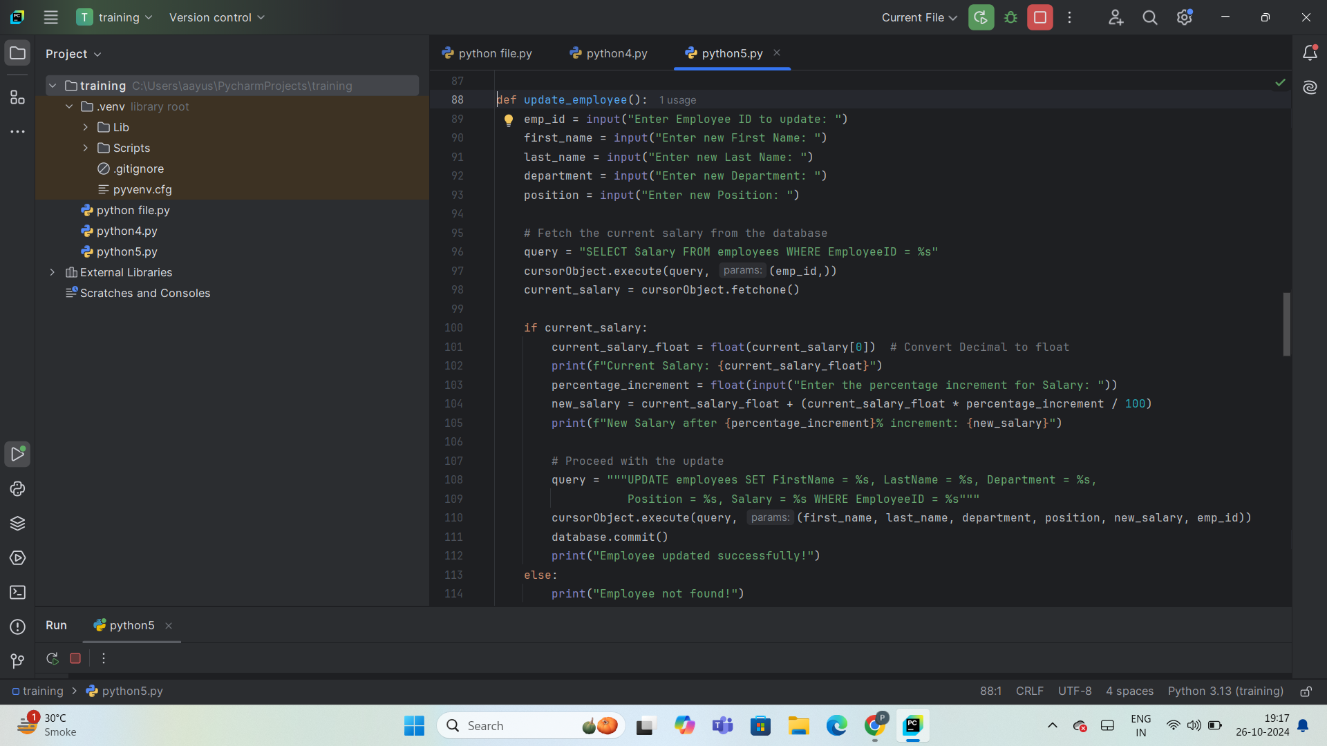
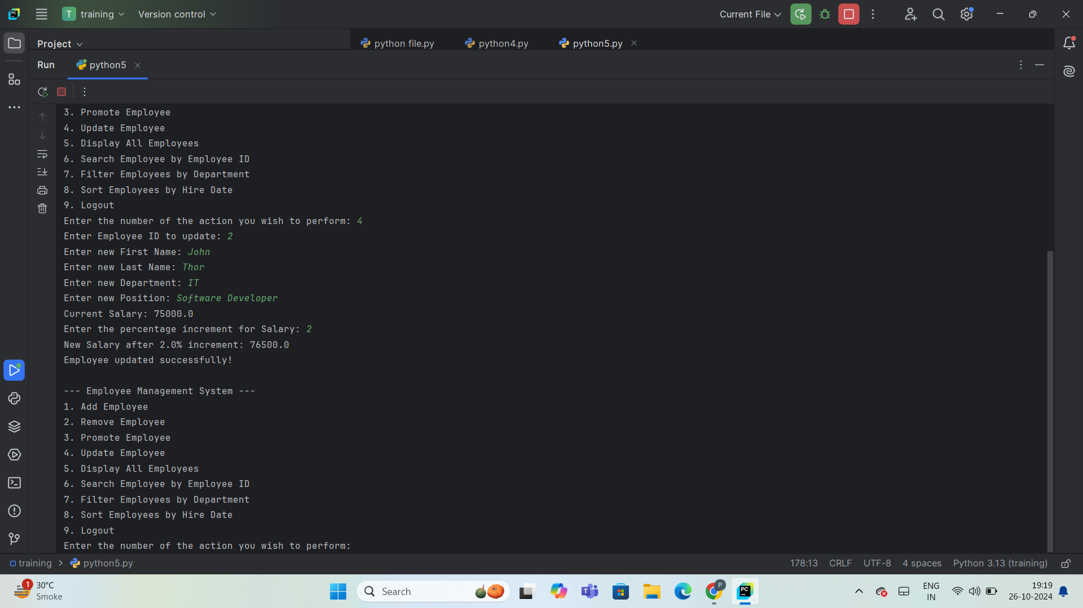
UPDATE EMPLOYEE
Purpose: Enables quick updates to employee details, ensuring up-to-date records.
Inputs Required:
Employee ID – Identifies the employee to update.
New Details – Includes First Name, Last Name, Department, and Position.
Increment Feature:
Provides an option to adjust the salary with a user-defined percentage increment.
Automatically calculates the new salary and displays it, helping streamline salary updates during promotions or performance adjustments.
Process Flow:
Step-1: Enter Employee ID, New First Name, Last Name, Department, and Position.
Step-2: System updates the database with the new details.
Step-3: Displays confirmation: "Employee updated successfully!"

Slide 13
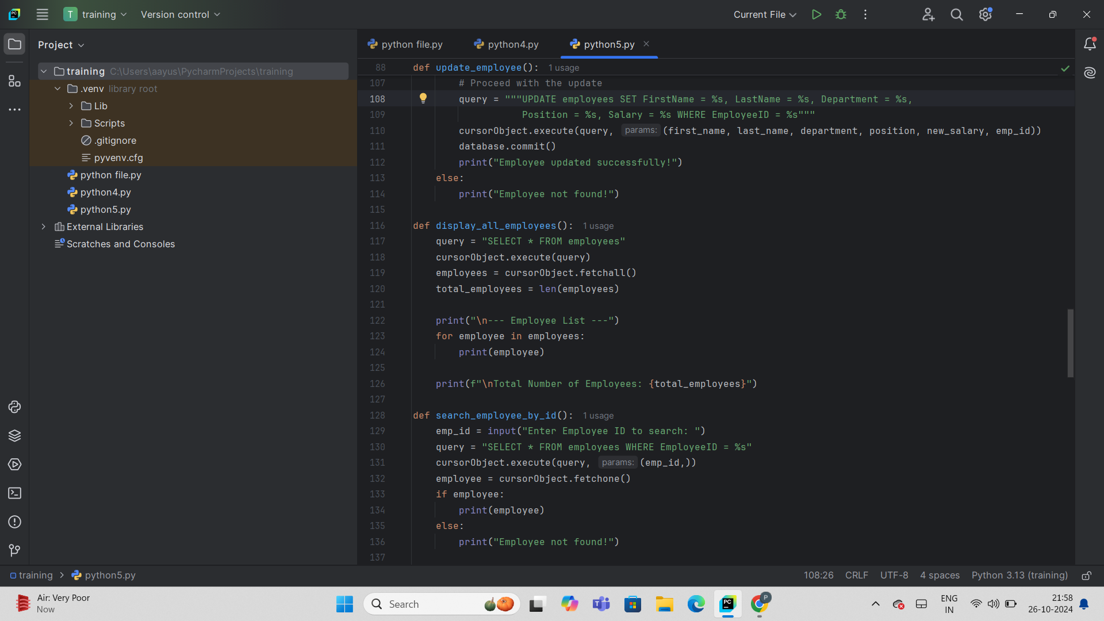
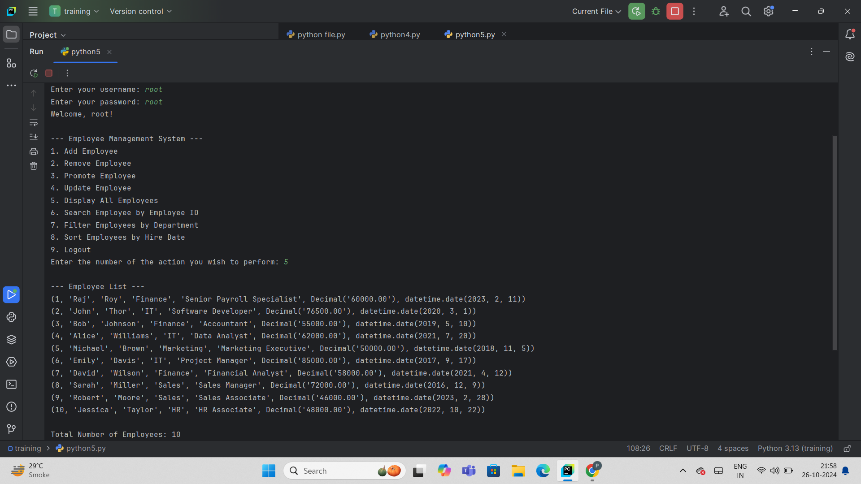
DISPLAY ALL EMPLOYEES
Purpose: To retrieve and display the complete list of employees stored in the database.
Functionality:
Step-1: Executes a SQL query to fetch all employee records from the employees table
Step-2: Retrieves details such as Employee ID, Name, Department, Position, Salary, and Hire Date.
Step-3: Displays each employee’s information in a structured format.
Step-4: Calculates and displays the total number of employees in the system.
Impact of Total Employee Count
Immediate snapshot of organizational size.
Validates employee record integrity.
Informs hiring, retention, and growth analysis.

Slide 14
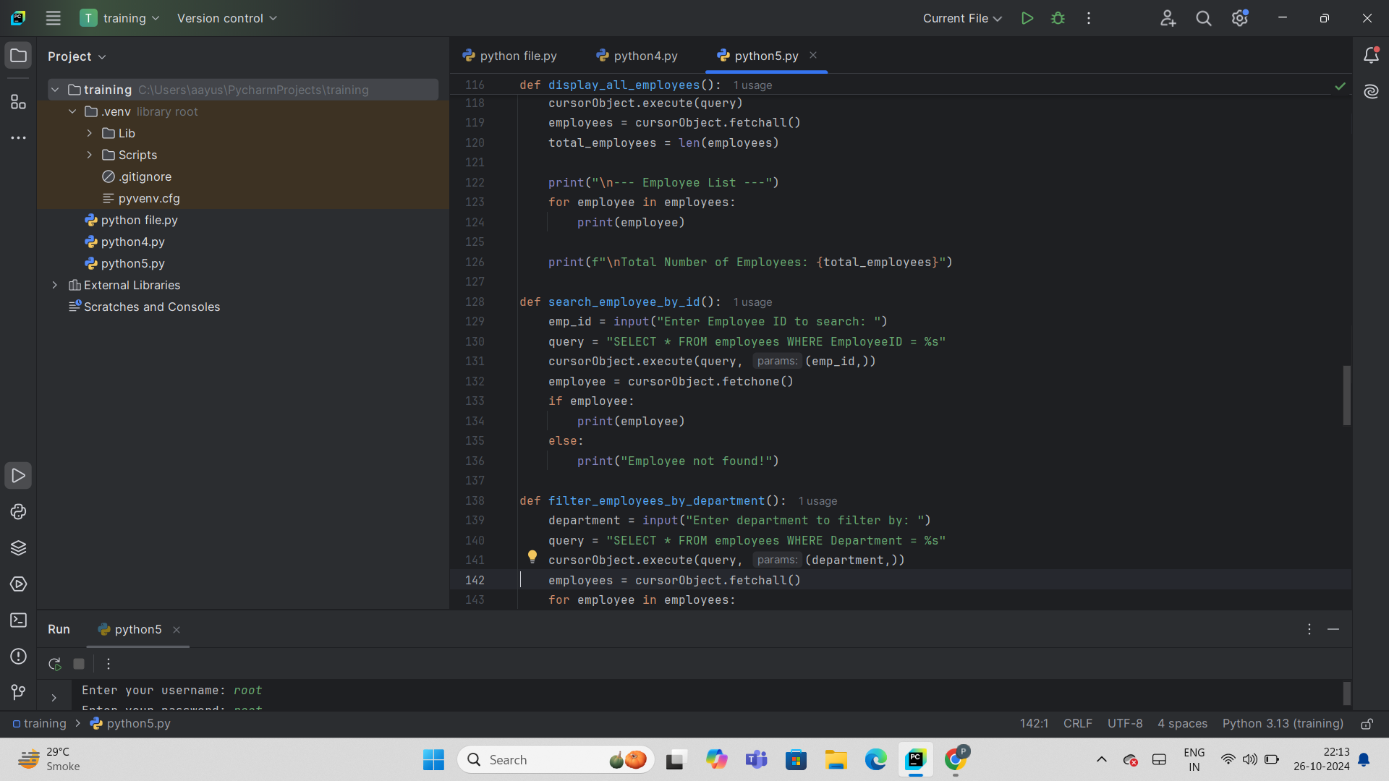
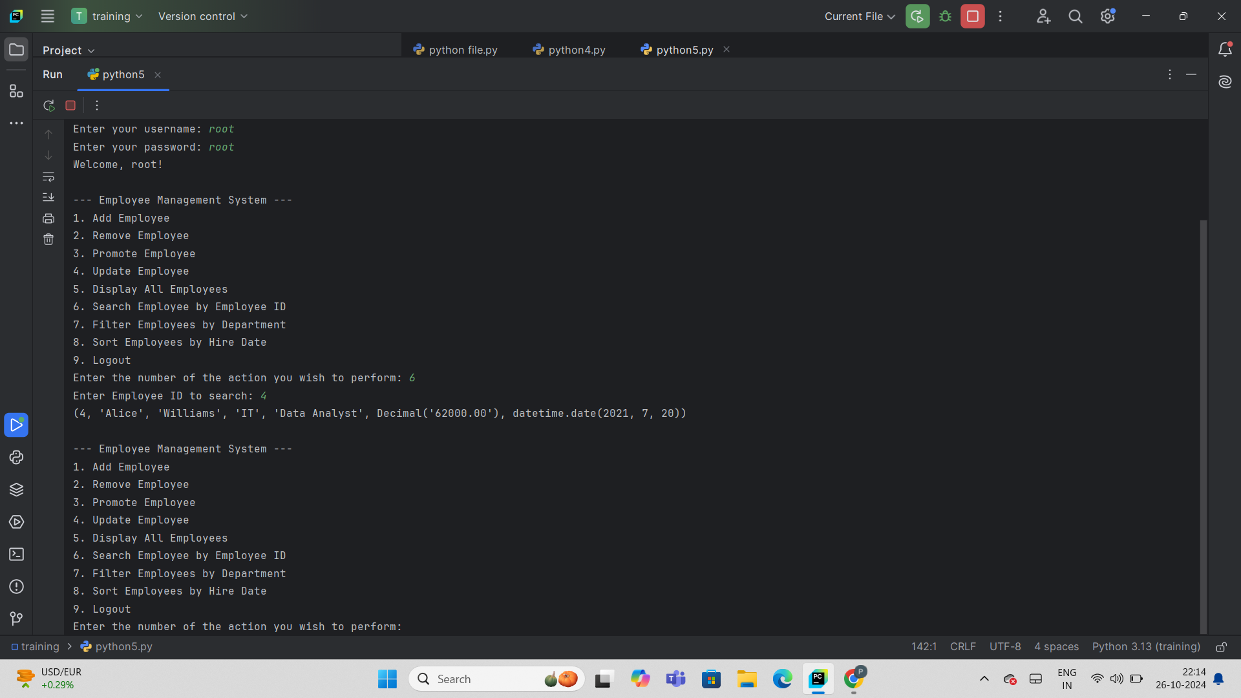
SEARCH EMPLOYEES
Purpose:
Enables users to retrieve specific records efficiently from a large dataset.
Quickly locate specific employee records by Employee ID.
Process Flow:
Step-1: User inputs search criteria (e.g., Employee ID).
Step-2: System constructs and executes an SQL query based on the input.
Step-3: Database is queried for matching records.
Step-4: If a record is found, details are displayed; if not, a "Record not found" message is shown.
Step-5: System returns to the main menu for further actions.
Impact:
Saves time with quick data retrieval.
Reduces human error in data searches.
Provides easy access to specific records.

Slide 15
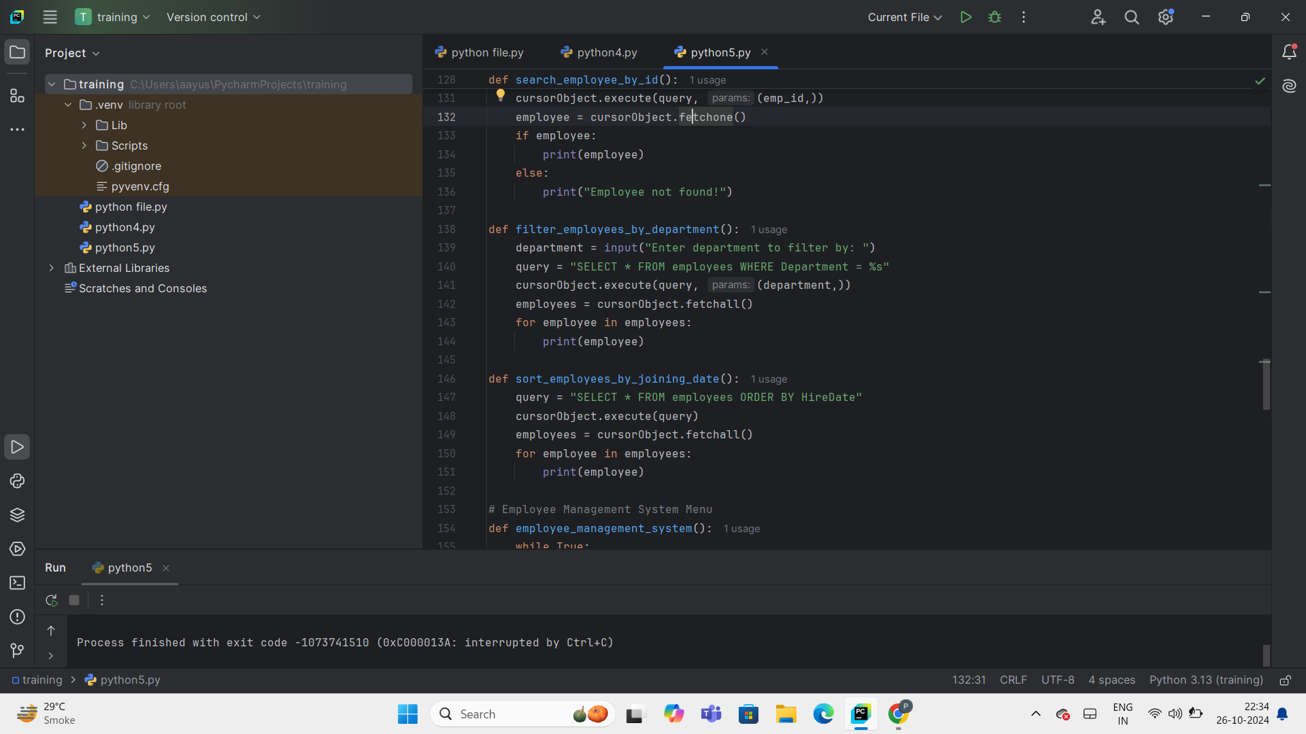
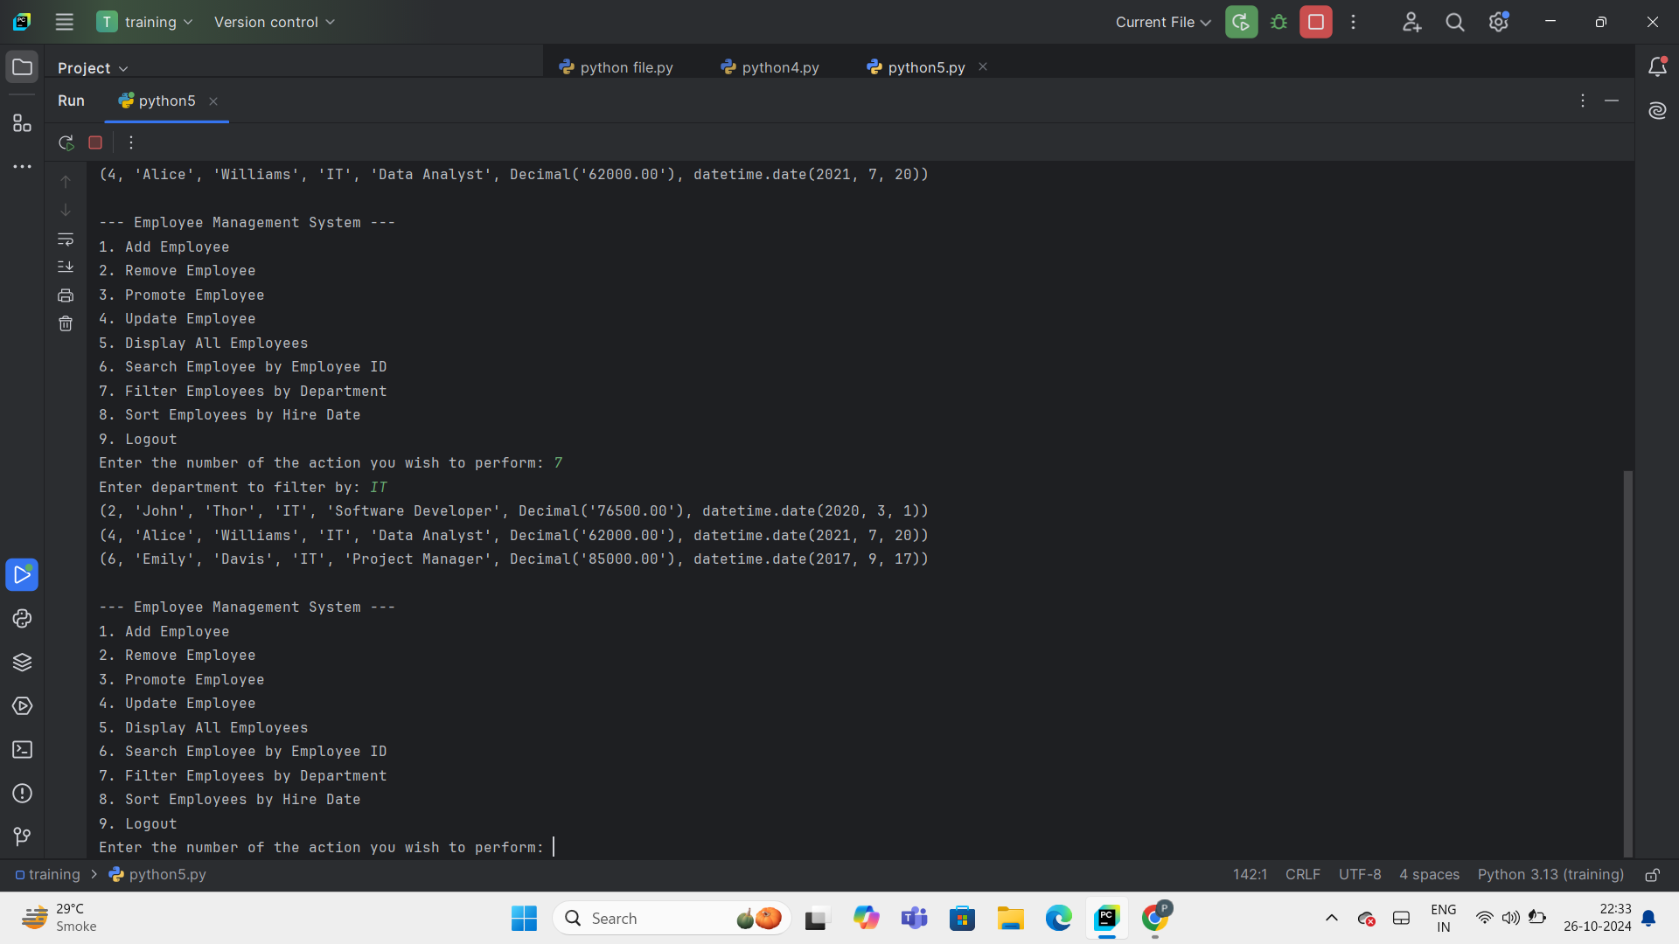
FILTER EMPLOYEES
Purpose: Simplifies data retrieval by focusing on specific criteria like department, making it easier to manage and analyze employee information.
Process Flow:
Step-1: User inputs department name.
Step-2: System executes an SQL query to retrieve employees in that department.
Step-3: Results are displayed with details like name, position, and hire date.
Impact:
Enables quick access to department-specific data.
Reduces time spent searching through large datasets.
Minimizes risk of error in data analysis or reporting.
Enhances usability by providing targeted information for managers and HR.

Slide 16
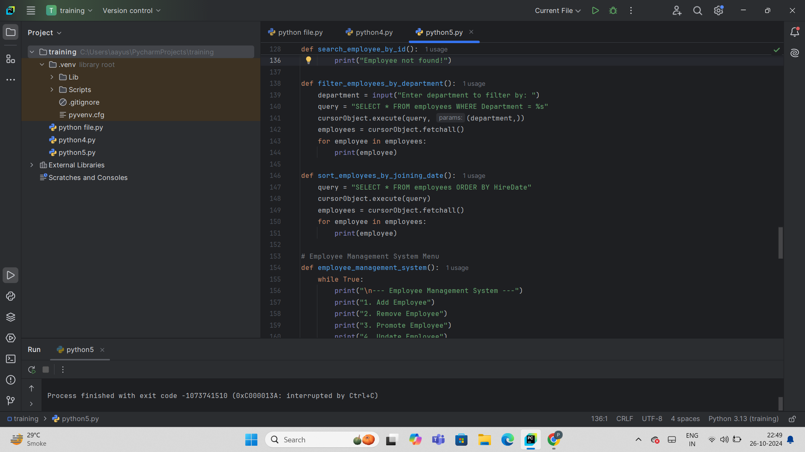
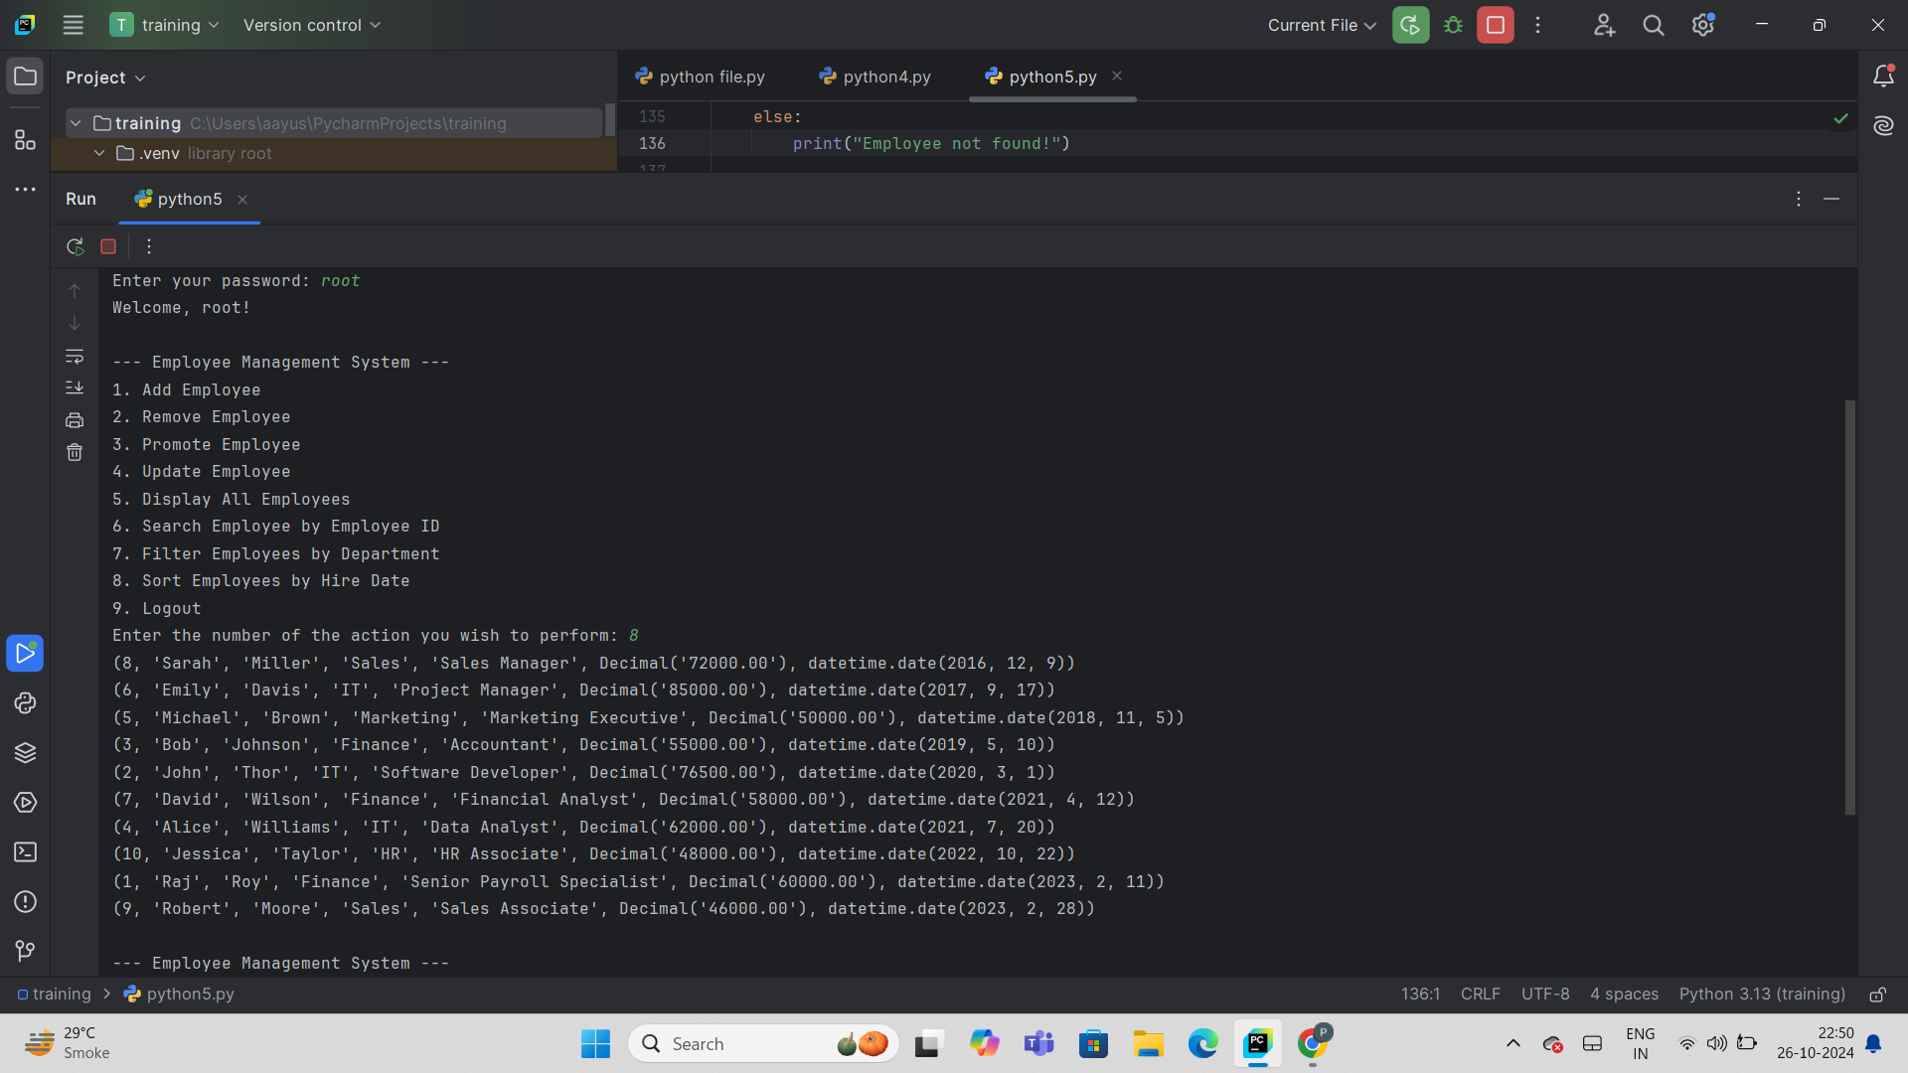
SORT EMPLOYEES
Purpose
The sort function arranges data systematically, making it easier to analyze and retrieve, based on parameters like date, name, or salary.
Sorting by hire date highlights seniority and aids in decisions on promotions, benefits eligibility, and workforce planning.
Process Flow
Step-1: Collects employee details.
Step-2: Saves data in a MySQL database.
Step-3: Sorts, filters, and updates records as needed.
Step-4: Presents sorted data in a readable format.
Impact
Facilitates efficient access to employee data.
Enhances decision-making for promotions, retention, and workforce distribution.
Automates sorting and filtering, reducing manual effort and errors.

Slide 17
LEARNINGS
Learned to install and configure PyCharm and SQL Workbench, enhancing my technical toolkit.
Built expertise in Python and MySQL, handling data with real-world applications.
Improved debugging and process optimization skills.
Each feature posed unique challenges, teaching me adaptability and a flexible problem-solving approach.
Recognized the importance of assessing each feature's impact, focusing on value-added development.
Practicing prioritization and time management helped ensure timely completion of multiple features.

Slide 18
